Slide 1
SOCIOTHON
“A strategy designed for improved education of rural schools”
Presented by-
Team - White Tiger
Akash Kumar Singh(CH)(Leader)
Rishav Kumar(CH)
Kishan Kumar Keshri(GT)
Pratyush Raj(BT)

Slide 2
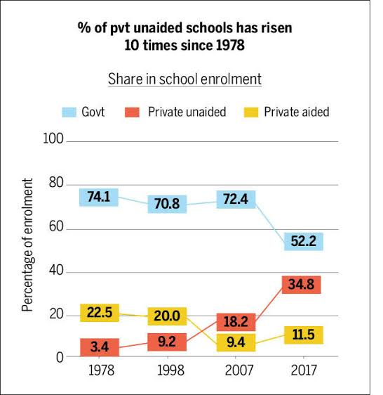
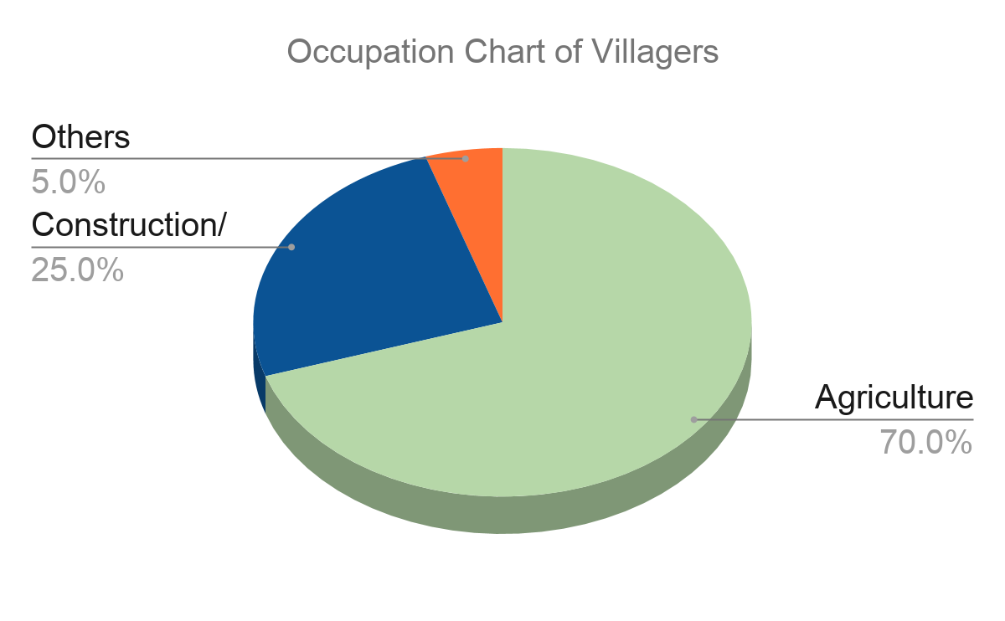
Current Scenario:
Primary rural government school in India:
Government School - 23.9% (share of children)
Lacking BMF (Basic Minimum Facilities)
4.6% GDP share on education
Status of “Ramuli Village”
Typical govt. School
Lack of exposure/awareness
Financial Constraint
Unskilled Teachers
Unenthusiastic Students

Slide 3
Problems and Our Approach:
Identification of issues :
Current working system of schools
  Academic and Administrative work of teacher
  Lack of rewards and recognition
  Complex working structure
Students
  Lack of representation and confidence
  Demotivated towards studies
  Unscientific mentality
  Limited picture of world & science
Financial constraints
Weaker Section
Less awareness
Funds are misused
Rural School
Teachers lack motivation
Solution Background :
Redesigning of Academic Calendar
  Right balance b/w practical and theoretical
  Structured and predefined events
Proper system for implementation
Fundraising for infrastructure and digitalisation
Inadequate BMF
Peer pressure
Workload of
staffs

Slide 4
Redesigned Academic calendar
Guidance and awareness
Co -curricular and extra activities
Learning outside school
Balance b/w theoretical and practical knowledge.
Career guidance
Awareness program
College students as volunteer
Student mentorship programme and motivation sessions
Organizing cultural events
Science competitions
Exhibitions
Sports meet
Cultural Meet
Agricultural field trips
    Bio gas
    Compost making
Industrial trips
Student exchange program with other schools
Educational trips

Slide 5
How this can be achieved?
Separating education from administration
Reporting must be digitalized and open sourced
Quality of visit relates salary of responsible officer
DM
(Monthly Report Meeting)
DEO
BDO
(Fortnight Report Analysis)
BEO
SI
(Weekly Visit to School)
Principal
OSD
(Managing Body)
Core Teachers
Non-core Teachers
(PT/Music Teacher)
Lab Maintenance
Self Improvement
Innovation
Reports & Feedback
Non-teaching works

Slide 6
Connecting Parents
STP MODEL
Teacher
Awareness
Enthusiasm
Motivate their children
Parents
Students
Formation of committee of parents .
Enlighten the parents to motivate their children.
Feedback will be taken from parents.
Educational innovation on strong foundation of community support and participation.

Slide 7
Fund Raising
RMSA
  multidimensional research, technical consulting, various implementations and funding support
NABARD
  Financial Literacy
  Exemption of fee for weaker section
  Rural Development (strengthening infrastructure)
CSR (Corporate Social Responsibility)
  Focus on healthy and more productive world
  Social and Economic development of Society
  Donation from Corporate Sectors
Now teacher can improve on their skills and provide consultancy to the villagers
Agri based
Dairy based
Technological Assistance
Teacher’s Knowledge
Govt. Resources
Villager’s Hardwork
Increased Profit
Overall Development
+
+
-->
-->

Slide 8
Scalability
Government with NGOs can mobilise village community to take responsibility for quality education.
Cluster formation of schools organisation.
Recruitment of OSD on basis of their management skills.
Exchange programme and Guest appearance.
The system based on “A teacher is always a learner”

